Slide 1

WORK SMARTER. NOT HARDER.
Machine Learning & ASC §842 Implementation

Slide 2

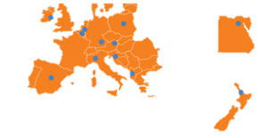
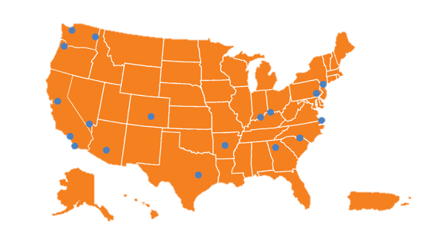
Md7 Overview
  Established in 2003
  Md7 is a global leader in wireless network property services specializing in Telecomm Real Estate, Site Acquisition, Lease Administration, Analytics and Project Management
  Executed on contracts in US:
    Top Wireless Service Providers, Tower Companies, Fiber infrastructure providers as well as Network Equipment Manufacturers and Integrators
  European Offices in Dublin & Maastricht Supporting:
    11 Service Providers across 12 countries

Slide 3
Our Experience
Site Acquisition… Lease Optimization…
Handled over 150,000 leases
Delivered over $1B in term savings
Interfaced with more than 100,000 landlords
15+ years of experience in telecom industry
Executed leases and amendments in 18 countries (incl. USA & Canada)
Abstracted and analysed over 75,000 leases
…in 12 different languages
…on 5 continents
Worked with 31 operators
Audits & Abstracts…
Construction Management…
Lease Administration & Landlord Management…
WORK SMARTER. NOT HARDER.

Slide 4

WHAT IS AI?

Slide 5
Buzzwords: What Do They Mean?
Machine Learning: The study of algorithms and statistical models that computer systems use to effectively perform a specific task without using explicit instructions. With machine learning, a computer program is said to learn from experience (E) with respect to a task (T) and some performance measure (P), if its performance on T, as measured by P, improves with experience E.
Artificial Intelligence: A field of computer science that pertains to any device that perceives its environment and takes actions that maximize its chance of successfully achieving its goals. Essentially, this is describing machines that mimic “cognitive” functions associated with the human mind.
Natural Language Processing: A field of computer science, artificial intelligence, and computational linguistics concerned with the interactions between computers and human (natural) language.
WORK SMARTER. NOT HARDER.

Slide 6

How is Md7 Utilizing This Technology? Contract Analyzer
- Leverages Machine Learning and Natural Language Processing
- Increase in accuracy over human abstraction
- 30%-90% time savings
- Self-training by non-tech professionals to extract custom terms
WORK SMARTER. NOT HARDER.

Slide 7
Where Is This Technology Headed?
Automated Contract Review
Automated Document Drafting
Smart Contracting
Blockchain Integration
Next level data/document management and integration
WORK SMARTER. NOT HARDER.

Slide 8

Case Study: ASC 842 Implementation

Slide 9
Case Study: Fortune 10 - ASC §842 Implementation
Purpose:
Advise Client on, and assist with, the implementation of the new ASC §842 regulations related to lease accounting as they pertain to Client’s potential lease documents.
Scope:
Review all real estate agreements (~8,000) expiring in 2019 to:
  Make a lease/non-lease determination applying the new ASC §842 standards.
  Make a finance/operating lease determination applying the new ASC §842 standards.
Consult with Client to develop the processes and procedures necessary for:
  The initial determinations related to the agreements renewing in 2019.
  The ongoing assessment of all agreements that are renewing by amendment, or newly executed.
  Developing and implementing the appropriate key controls to meet the requirements of SOX 404 and to help facilitate Client’s Auditor assessment as to design and effectiveness of key controls under SOX 404.
WORK SMARTER. NOT HARDER.

Slide 10

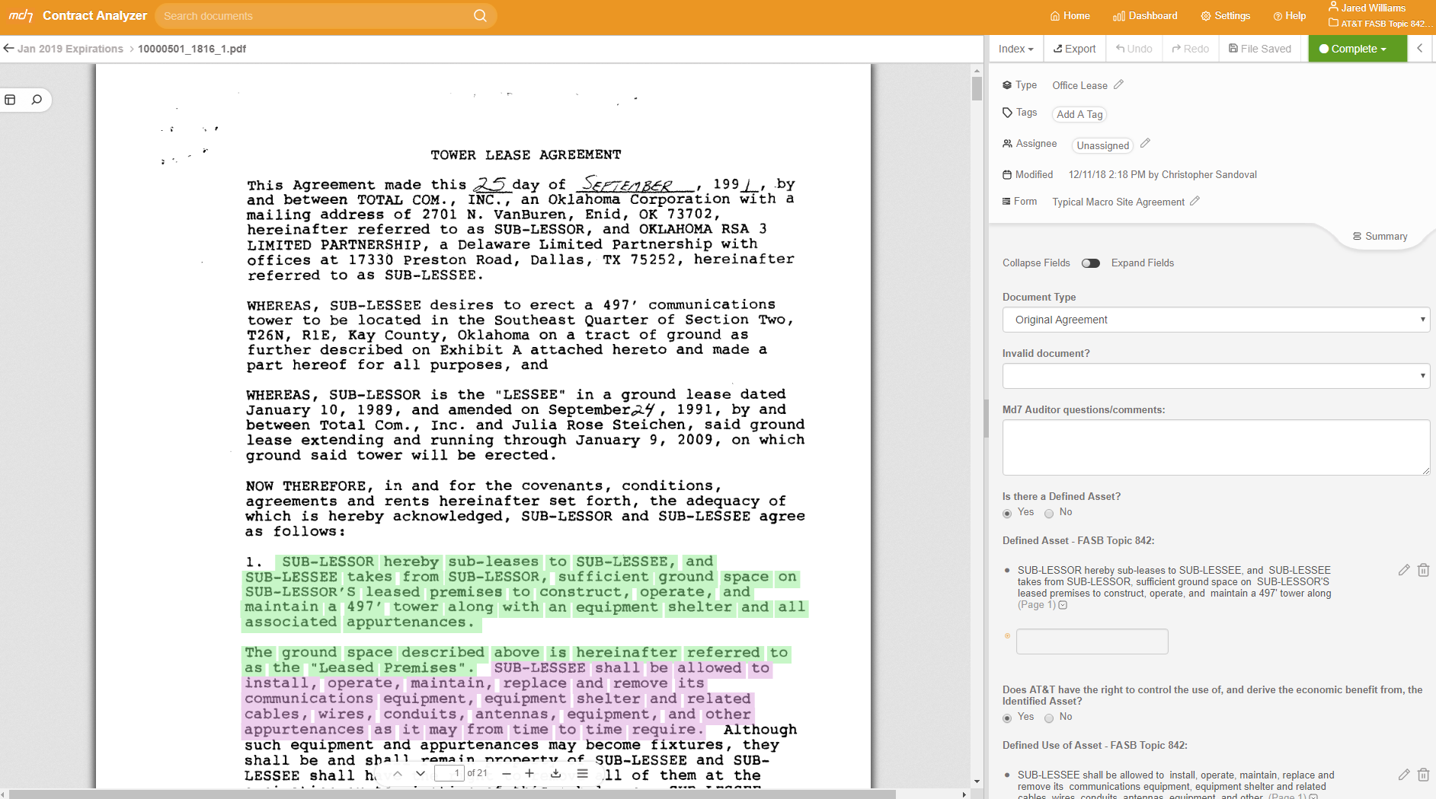

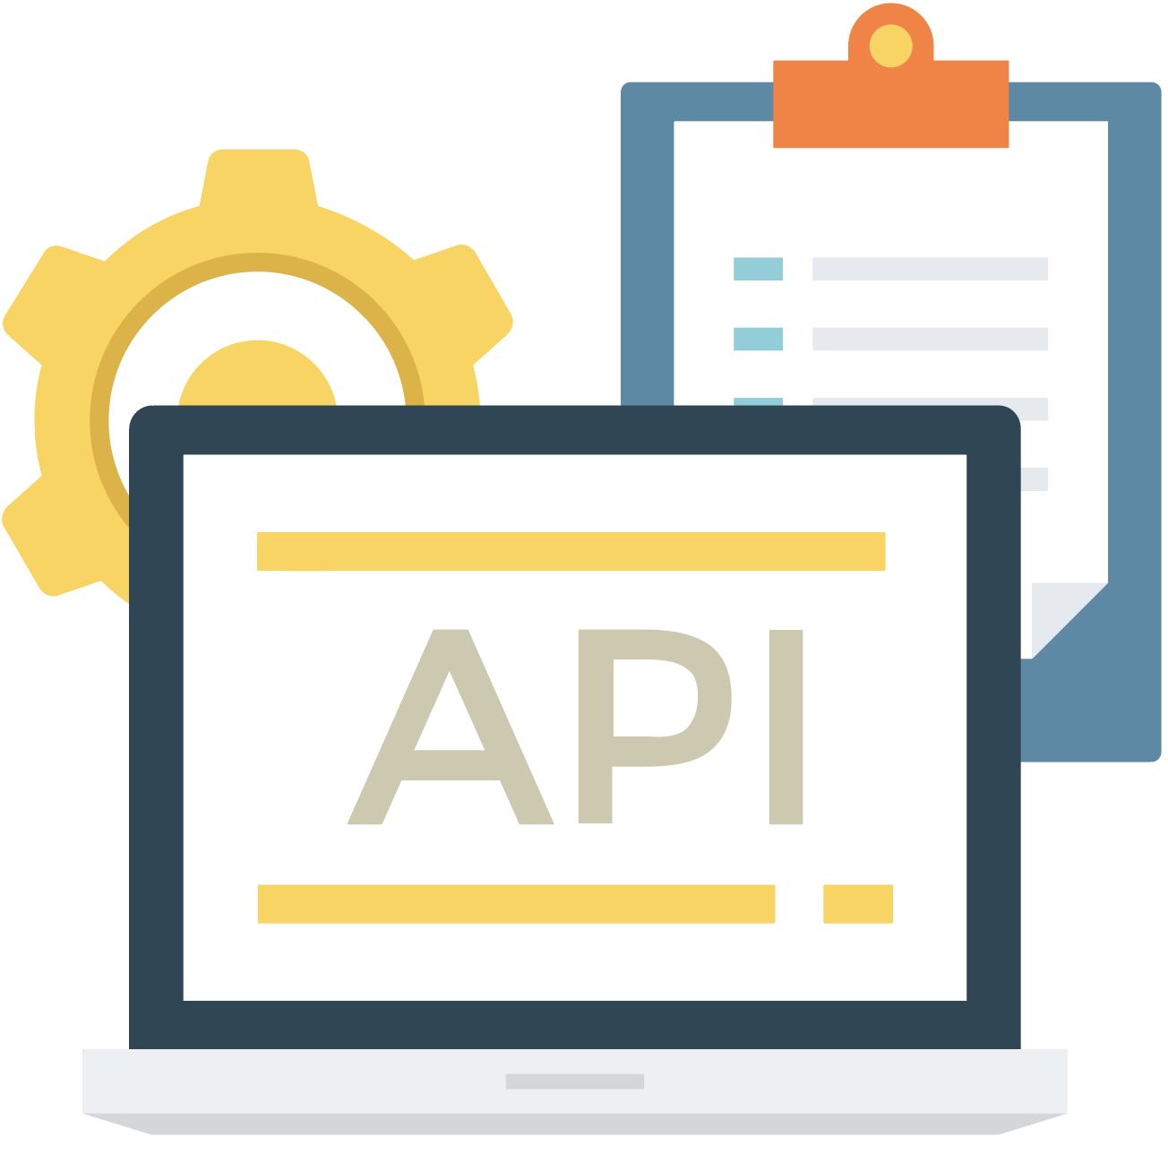
Case Study: Md7 Contract Analyzer: How Are We Conducting the Assessment
Function Within This Program
Md7 trains natural language based processing machine learning algorithms using Client agreements to locate language necessary for making lease/non-lease determinations.
Algorithms are then implemented and tested for accuracy and completeness. Once they have achieved certain accuracy levels, they are implemented.
The machine’s “work” is put through a quality control review as part of the assessment process by the person making the lease/non-lease determination, and a separate / subsequent quality control review of the actual lease/non-lease determination.
Machine learning is being leveraged to locate the following information in the agreements being reviewed by Md7
  Defined Asset
  Defined Use of Asset
  Substitution Rights
Trained using telecom leases for the abstraction of telecom leases.
Pre-trained rules and provisions are specific to telecom leases.
Trained by LAWYERS with over 20 years combined experience in telecom.
Trained to INTERPRET telecom lease language, not just locate it.
Tested/proven accuracy in abstracting telecom leases for major wireless operators.
WORK SMARTER. NOT HARDER.

Slide 11
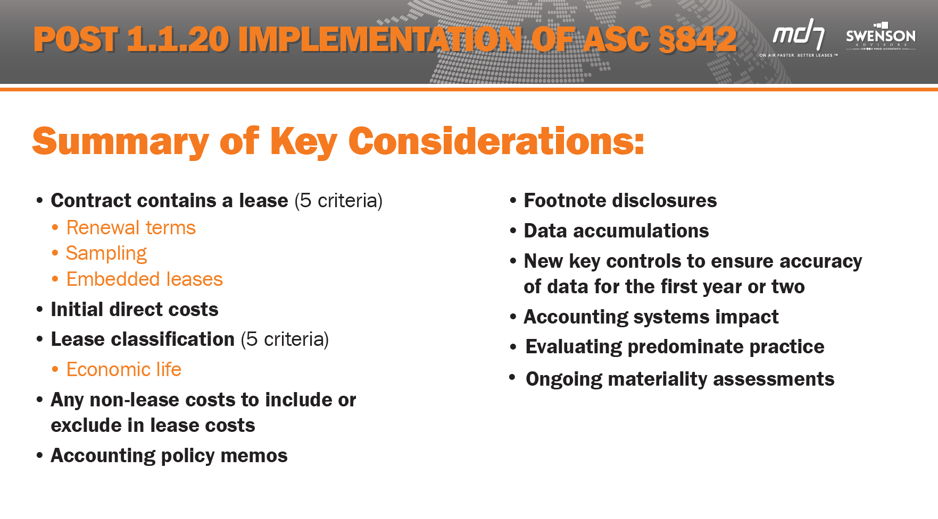
Case Study: Fortune 10 - ASC §842 Implementation

Slide 12
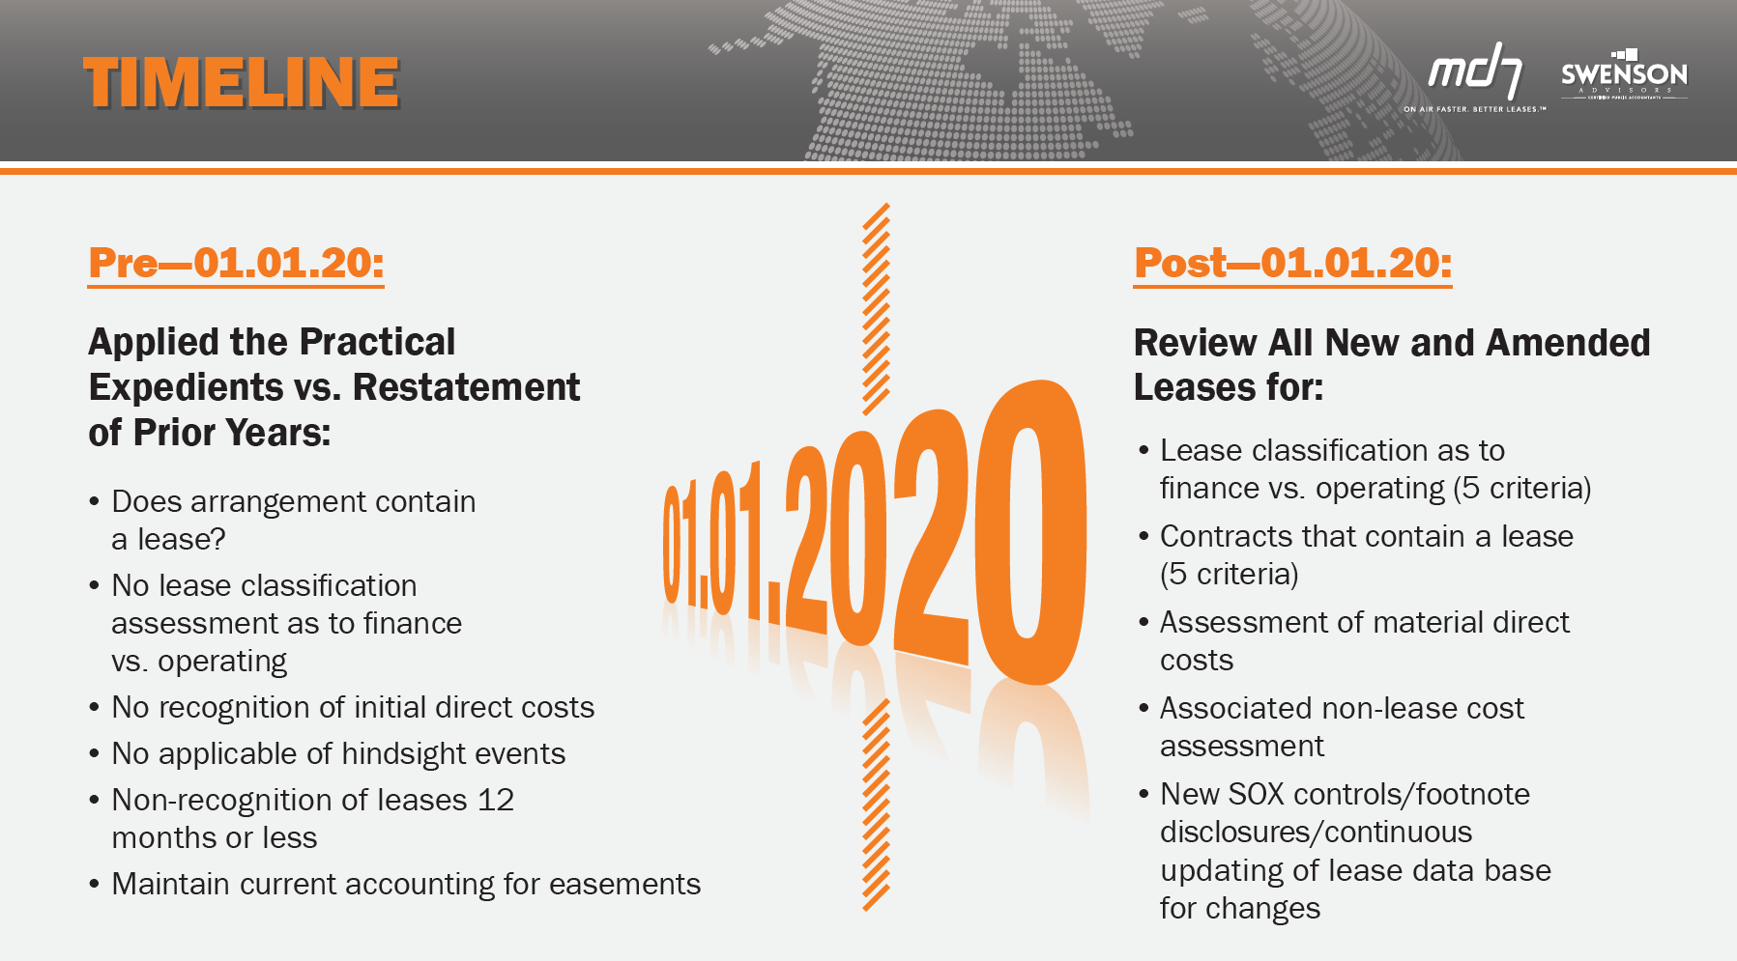
Case Study: Fortune 10 - ASC §842 Implementation

Slide 13
Case Study: Fortune 10 - ASC §842 Implementation
Risks Associated with ASC §842 Implementation
Data Collection/Incorrect Data Inputs
Document Management and Completeness
Misapplication of Topic §842
Misapplication of the Practical Expedients
Lease Classification
Contracts Do or Do Not Contain a Lease
Machine Learning Risk
Rollup of Data to Lease Accounting Footnote Disclosure
WORK SMARTER. NOT HARDER.

Slide 14
WORK SMARTER. NOT HARDER.
Questions

